Slide 1
Architecting Virtual Machine Solutions
Notes:
Session Abstract: Virtual machines in Azure are very easy to get started with. Simply provide an image for a new virtual machine instance or choose one from the gallery and you’ll be up and running in no time. Just like with on-premises solutions, there are best practices to follow when designing solutions comprised of virtual machines. We will discuss best practices for specific workloads such as identity and database workloads and will highlight the areas that Architects need to remember when designing complex solutions in the cloud.

Slide 2
Agenda
Best practices for AD in IaaS
Best practices for SQL database solutions
Designing complex solutions in the cloud
Notes:
In this session, we are assuming that you understand the fundamentals of Azure virtual machines. We will dive into 2 of the most common workloads, Active directory and SQL server. We will understand these scenarios a bit more and point out the different issues you may encounter when deploying these workloads.
We feel that understanding how to plan and deploy these workloads on Azure, you will have a good foundation on the different options available when designing your IAAS solutions.

Slide 3
Some Common Misconceptions
“Oh, it’s just VMs in the cloud”
“Just like private cloud on prem”
“Microsoft hosts a bunch of Hyper servers in their datacenter”
Notes:
We want to clear up some common misconceptions heard when comparing IAAS on Azure to Onpremises workloads, co-hosters or managed service providers.

Slide 4
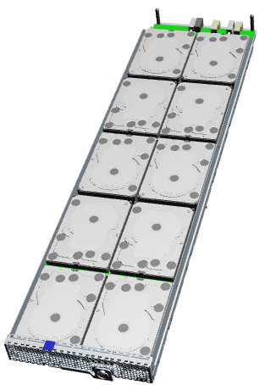
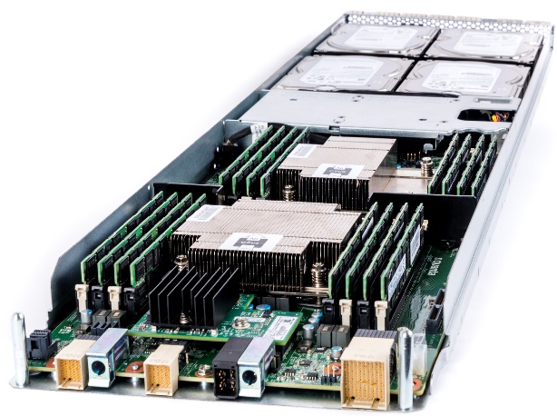
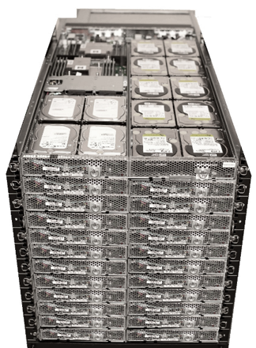
Open CloudServer V2 system
Compute blade
Dual socket Intel E5-2400 v2 Family
4 x LFF HDD, 2 x SFF SSD
2x10G networking
Dual 4X SAS 6G
Storage 6G JBOD
10 x LFF SATA HDD
Dual 4X SAS 6G
6G SAS expander
Notes:
The servers that run Azure are custom. Designed for hyperscale. They are mostly cableless designs to reduce accidental cable disconnects. Power is distributed through the back plane so a tray of blades can be slid into the 1U rack, and be available quickly.
((The FLAs on this page))
LFF == Large Form Factor == 3.5" hard drive
SFF == Small Form Factor == 2.5" hard drive
Cloud services are written very differently than other applications. The applications are written with the understanding that the hardware has just enough reliability, but no more. Software is used to drive up the reliability of the total service and drive down the cost of hardware.
For large scale efficiency, the entire stack from silicon, to the Datacenter are fully integrated and optimized. Microsoft has contributed it’s specifications to enable standardization of these optimizations throughout the industry. The v2 chassis supports both compute and storage blades.
<<click>>
The high performance compute blade with the latest Intel processors supports the storage JBOD blades through dual 4X SAS expansion. The blade has been upgraded from v1’s 6G to 12G SAS connections.
<<click>>
It is compatible with the v1 Storage JBOD. Each compute blade can support up to 480TB storage via 80 HDDs in 8 JBOD blades. They are managed using custom software to reduce the depenecy on different vendor stacks. You can imagine how data is shred across different blades, disks, racks, etc.
<<click>>
The blades can be any combination of compute or storage to meet flexible requirements. Management of the blades and chassis is through the Chassis Manager, an x86 PC. The Chassis Manager is responsible for setting fan speeds, monitoring the health of power supplies and fans, and for the minimum set of out of band features required for running the servers. This includes on, off, fan speed settings, and gathering event logs.
There are six shared power supplies that allow for balanced three-phase power at the datacenter that allows the datacenter to be fully utilized. Six large fans are used to reduce power consumption and enable fault redundancy. The assembly is designed for low-cost manufacturing and pre-rack assembly before arriving at the datacenter.
<<click>>
Here is what a full rack of servers look like. Utilizing a standard 19” EIA rack was very important to creating a flexible platform. To increase overall efficiency, the management, cooling and power is pooled and shared across 24 blades.

Slide 5
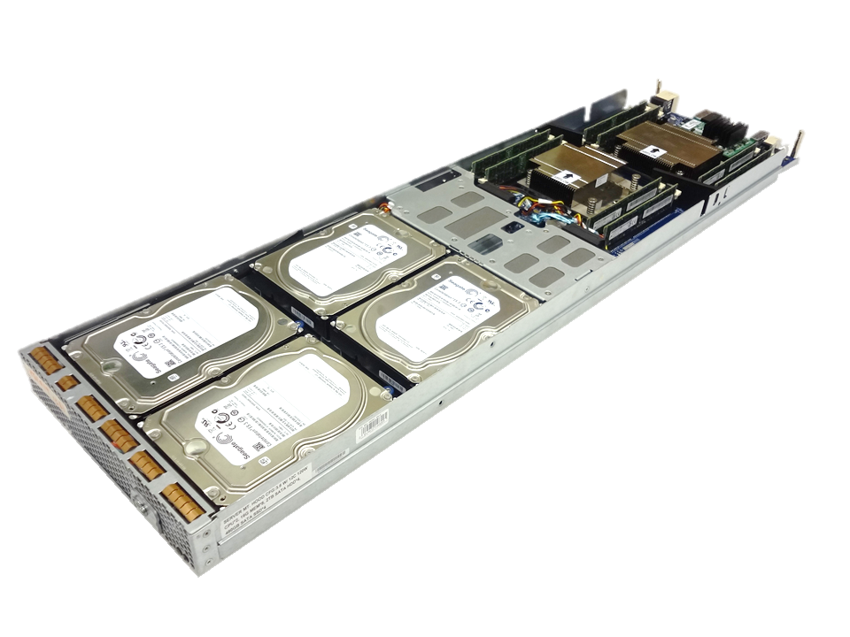
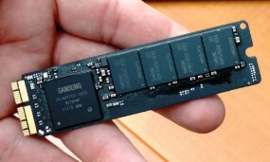
Open CloudServer V2 Design
X16 PCIe for
accelerators
28 CPU cores for high performance – Intel Xeon E5-2600 v3
Advanced networking – 40Gbe with ROCE v2
8TB of M.2 PCIe SSDs - low cost, high bandwidth commodity flash
512GB DRAM for data intensive workloads
Accelerator card expansion – GPU, FPGA
High efficiency 1600W PSU optimized for hyper-scale datacenters
40GbE NIC
with ROCE v2
Dual-socket 120W
14c CPUs
M.2 Flash solid-state storage
Notes:
The heart of the Open CloudServer V2 upgrade is a new compute blade. This blade supports the latest Intel processor enabling 28 cores per blade. More cores enables more virtual machines leading to a need to rebalance the system.
We’ve added capacity increases in all of the other subsystems on the blade. This blade supports the transition from 10G networking to 40G networking. We utilize RDMA over Converged Ethernet, ROCE v2, to improve network efficiencies moving data to and from storage.
We’ve increased the SSD flash capacity by 4X by transitioning away from SATA-based SSD flash storage to the PCI-Express based M.2 form factor. The M.2 flash cards are used in most laptops and tablets today and are transitioning to the high performance NVMe interface. The M.2’s small “stick” form factors allows for thermal efficiency improvements and lower overall power consumption of fans.
To improve the efficiencies of the processors, we’ve enabled an expansion card that can be used for things such as GPU and FPGA accelerator cards. In the chassis we’ve increased the capacity of the power supplies and optimized them for cloud datacenter designs.
Emphasize - The overall result is that a full 52U rack with 96 servers can support 2688 cores, 48TB memory, 2.3 PB disk storage, 3/4ths PB flash storage, and 3.8 Tbps network bandwidth. Microsoft has 10’s of 1,000’s of these!!!

Slide 6
Active Directory in Azure
Notes:
Let dive into the first workload, AD on Azure

Slide 7
Why AD in the Azure?
Migration of existing “classic” workloads
Apps not born in the cloud
Application transitions and stand alone applications
Disaster recovery
Dev, test, patching, app compatibility testing
Hybrid
Notes:
AD in Azure can be used for a variety of common on-prem workloads, hybrid or dev and test. Other workloads like standalone legacy apps can also be candidates to move to Azure.
Classic workloads, those based on the domain based, common identity store architecture such as SharePoint, are also candidates for IAAS.

Slide 8
How Do Customers Run AD On Azure Today?
Deploy a site-to-site VPN connections between workloads
On Azure Infrastructure Services
On-premises
Set up replica domain controllers using Azure virtual machines
Deploy a stand-alone domain controllers in Azure

Slide 9
“NEW” AD in Azure in 10 steps
Plan network (IPs, VNets, DNS)
Create availably set/resource group
Create storage account
Create network
Create Machine 1 with extra data disk for SYSVOL (no caching)
Promote to DC
Create Machine 2 like machine 1 in availability set
Join domain
[Recommended] Secure communication endpoints
[Optional] Create jump server for RDP access
Notes:
Deploy a Windows Azure Virtual Network
By default, VMS Use DHCP-leased addresses on your virtual DCs. this is NOT an option
Install and configure Windows Server DNS on the domain controller(s) in Windows Azure
Configure both the DCs’ and the domain-members’ DNS client resolver settings as follows:
Preferred DNS server: on-premises DNS IP address if using Hybrid
Alternate DNS server: loopback address or another DNS server running on a DC on the same virtual network
Always create at least 2

Slide 10

Availability Sets
Availability set
SLA High Availability
Hardware and Software
Windows and Linux
Virtual Machine
Virtual Machine
SQL Server
Primary
SQL Server
Secondary
SLA 99.95

Slide 11
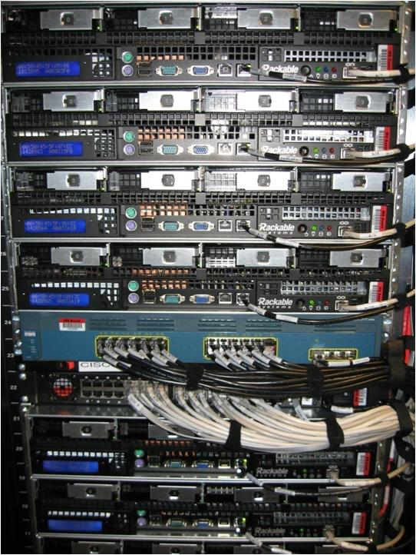
Availability Sets
Physical Machines
Power Unit
Rack Switch

Slide 12

Availability Sets
Physical Machines
Power Unit
Rack Switch
VM1
VM2
VM2
VM1
VM2
Availability Set

Slide 13
Deploy domain controllers in an availability group
Notes:
In this demo, we will provision a new AD forest, with 2 machines. The second machine will not be joined to the domain..we will walk though that process in another demo.
Deploy a new server to the same vnet
Log on to DC
Create a new user account with domain admin
Try to join
Watch it fail
Configure DNS
Try to join with domains creds
Logon with domain creds instead of local creds
Ensure it is in an availability set

Slide 14
General Considerations for AD In Azure
Domain controllers are highly sensitive roles
Best choice for IaaS workloads
Should mirror existing datacenter environment with respect to replica domain requirements
Read-Only Domain Controllers
Built for situations with poor physical security
Poor choice for Azure, does not address IaaS needs
Resource Forest (watch out)
Unless currently in place on-premises this posture can hinder migration efforts

Slide 15
AD Deployment In Azure
Use machine profiles adapted to the DIT size
Consider the memory intensive machines (A5-A7) for large ADs
Migration Path choices
Physical to Virtual
Move existing virtual
Build new DC and replicate from on-premises
Azure Application Access
Create AD site for each Azure region and attach all regional subnets to that site
Place two DCs in each region within an Availability Set
Notes:
((DIT = directory information tree, the size of the directory database on disk NTDS.dit))

Slide 16
Linux AD Authentication
Three main variants
LDAP Authentication / Authorization
Kerberos 5 Authentication / LDAP Authorization
Winbind Authentication / Authorization
Considerations
Single Sign-On or Same Sign-On?
Password change capabilities
Authentication and/or Authorization and/or File Sharing?
Deployment Size and Administrative Impact
Notes:
Including several commercial components there are at least 5 ways to integrate Linux VMs with Active Directory. The three main variants are all based on built-in or freely available components. Which one is right for you depends on various considerations, and even within the various solutions there are various configurations influenced by your requirements. The Winbind solution alone supports 10 different configurations.
Whether you support Single Sign-On or Same Sign-On can make a big difference. In the former scenario users are directly authentication against AD, in the latter scenario username and password (hash) are stored locally and synchronized regularly. This improves performance, but also means users can’t change their password from within the Linux client. In addition, password changes may not be immediately synchronized to all clients.
The different solutions and configurations vary wildly in complexity. Just implementing some services may decrease the complexity enormously, so you need to carefully consider which services you really need.
A major factor when it comes to the right solution and configuration is the deployment size. Several options are limited in scalability and may require manual actions, for instance when a user is added to the directory. For larger deployments manual actions should be avoided as much as possible, but to achieve that a more complex configuration may be required.

Slide 17
Linux Client LDAP Authentication
Applications
(GDM, SSH, ...)
NSS
LDAP
nss_ldap
LDAP
PAM
Kerberos
KDC
pam_ldap
Linux Client
Active Directory
Notes:
LDAP Authentication and Authorization utilizes the fact that Active Directory is fully LDAP compliant. Applications work with NSS (Name Service Switch) and PAM (Plugable Authentication Module), which use LDAP modules to talk to the LDAP endpoint of Active Directory. We recommend always using LDAPS, so credentials don’t go over the network unsecured. This requires using a certificate on Active Directory Domain Controllers. This certificate must be trusted by the Linux clients, which is best done by adding a Certificate Authority to your network trusted by both Windows and Linux.
With LDAP Authentication users can’t change their password from the Linux client. To ensure password safety you should implement a password change process that conforms to your password expiration policy. Either by providing users a method to change their password, or by having an (automated) password refresh mechanism in place.

Slide 18
Linux Client Kerberos Authentication
Applications
(GDM, SSH, ...)
NSS
LDAP
LDAP
nss_ldap
PAM
Kerberos
Kerberos
KDC
pam_krb5
Linux Client
Active Directory
Notes:
With Kerberos Authentication NSS still uses LDAP, and works the same as with LDAP Authentication, but PAM makes use of the pam_krb5 module to authenticate against the Kerberos Key Distribution Center (KDC) implemented in Active Directory. This is a popular configuration, because it works with out-of-the-box components in a secure way, and it provides password change capabilities.

Slide 19
Linux Client Winbind Authentication
Applications
(GDM, SSH, ...)
NSS
Winbind
Deamon
LDAP
RPC
nss_winbind
ADDS
idmap
Backend
Kerberos
NTLM
PAM
pam_windbind
Linux Client
Active Directory
Guidance: http://bit.ly/RHEL6AD
Notes:
Winbind is the more complex solution, requiring a Winbind deamon to run in the Linux clients. Winbind provides more capabilities at a technical level, such as support for RPC and NTLM, and does not require any specific components (Services for UNIX) in Windows. Winbind is part of the Samba interoperability suite, which also provides file sharing capabilities using the SMB protocol. If you plan to use SMB, using Winbind is a logical choice.
Red Hat has provided guidance on implementing Winbind, which you can find at the given link. A key aspect is choosing the right idmap backend. This defines the way IDs in Windows and Linux are mapped, and each carry with it some advantages and disadvantages. The guidance document describes this in great detail.

Slide 20
Domain Controllers in separate regions

Slide 21
AD on IaaS Tips
If you know you will need to shut it down, use 1 DC
For production, use 3 DCs in the same availability set
Distributes across update and fault domains
Potential for all DCs to restore from an unknown state
3 provides for at least 1 authoritive SYSVOL
Choosing a DC, GC or RODC?
Cloud only – yes
Hybrid – maybe
RODC – primarily used for insecure environments
Notes:
Some tips when looking at AD in Azure workloads
If there is a possibility that you will need to turn off the DC for cost (example dev and test), the only deploy 1 DC. Multiple DCs that are deallocated may cause orphaned objects when they are brought back online (who is authoritve??)
For prod workloads, make sure you deploy at least 3. This allows you patch and still be highly available
When making a choice between the standard DC roles, look at the possible workload. If it is cloud only workload, then yes. For hybrid. You will have to look at the connectivity options and the reasons you are using Azure.
RODC are primarily used for branch scenarios, when there is a possibility that your physical DC will walk away. Not recommended for Azure.

Slide 22
Isolate AD Machines For Security
Three basic options for machine isolation:
Between machines deployed to a single virtual network - Windows Firewall
Between machines deployed to distinct virtual networks - Same cloud service
Between machines to distinct virtual networks
VPN connection from on-premises
Notes:
When you deploy your AD workload, use a separate resource group and network group to isolate it from other machines. This helps to protect the servers from attack. There are various options for isolation.
In order to secure the server, Windows Firewall could be configured to block all inbound connections, and inbound rules would be setup to determine:
1) what local ports will accept connections,
2) what remote ports from which connections will be accepted,
3) what remote IP addresses will be accepted,
4) what authorized users can make connections, and
5) what authorized computers can make connections

Slide 23
SQL in Azure

Slide 24
Why SQL in Azure IaaS?
If SQL PAAS has a limitation
Other Scenarios
License portability
Backup
Dev and test
Hybrid apps
Legacy applications (either 1st or 3rd party)
PAAS integration scenarios

Slide 25
Migrating Database Server Options
Bring your own image
Use the Gallery image
Upload VHD to Microsoft Azure storage account
instantiate virtual machine
SQL Server 2008 and up
License mobility with software assurance
Latest SQL Version (2014)
Default options
Includes SQL Server Integration Services, Reporting Services, and Analysis Services
Images refreshed monthly
Once deployed, you patch
Notes:
There are different options for moving the server vs. the data
You can move your exsting server or choose from the gallery
Then you have to get your data
VHD, VHDX
SQL backup restore
MDF – LDF Copy

Slide 26

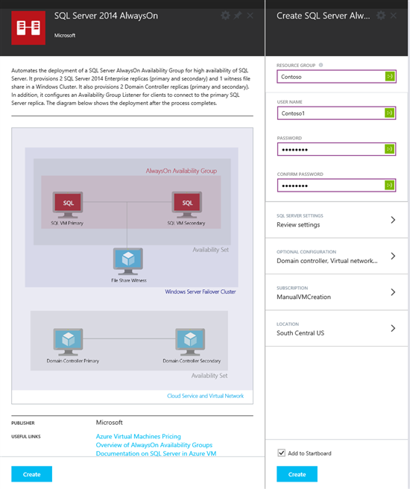
Microsoft Azure SQL Server Templates
Templates to create a complete environment out of the box are available
Automates the creation of a SQL Server AlwaysOn Availability Group
Taking care of the setup steps behind the scenes
26
Notes:
Use Azure Templates to provision and deploy Azure resources in seconds
An Azure Template is a description of an Azure application's resources
Notifications show details that occur when you use an Azure Template
The Website + SQL Azure Template
Azure Templates are described using JSON

Slide 27
SQL Server (or other I/O hogs)
IaaS blob storage provides 0-500 IOPS
Can be anything in that range
No performance SLA, just an availability SLA
Consider leveraging multiple data disks
Follow guidelines in the Azure SQL Server Whitepaper
http://msdn.microsoft.com/en-us/library/windowsazure/dn248436.aspx
Remember your on-premises troubleshooting
Notes:
Standard Disks in Azure are throttled to 500 iops !!
Given OS Activity, you’ll end up with ~150 iops on the C:\ drive
Storage Account is throttled at 20.000 requests per second / 60 MB per second (theory)
20.000 / 500 = 40 – so try to not put more than 40 VHDs in a single Storage Account
First solution = add Data Disks, and stripe them as Simple Storage Spaces
8 disks = 8 x 500 iops = 4000 iops
Allocation Unit Size = Space Interleave = 64kb
Number of Columns = number of Data Disks

Slide 28
Additional Considerations for Data Disks
Disk warm-up
NTFS Allocation Unit Size?
Single vs. multiple storage accounts with a single VM
DO NOT SPREAD DATA FILES OF A SINGLE DATABASE INTO MULTIPLE STORAGE ACCOUNTS !!!
Data in different blobs not written at the same time
BLOBs that make up the stripe set could be out of sync
Instead:
Spread the data files across multiple disks to achieve higher IOPS/bandwidth
Note: a storage account has a limit of 20K tps
Notes:
Effects of warm-up on data disks
With Azure disks, we have observed a “warm-up effect” that can result in a reduced rate of throughput and bandwidth for a short period of time. In situations where a data disk is not accessed for a period of time (approximately 20 minutes), adaptive partitioning and load balancing mechanisms kick in. If the disk is accessed while these algorithms are active, you may notice some degradation in throughput and bandwidth for a short period of time (approximately 10 minutes), after which they return to their normal levels. This warm-up effect happens because of the adaptive partitioning and load balancing mechanism of Azure, which dynamically adjusts to workload changes in a multi-tenant storage environment. You may observe similar effects in other widely known cloud storage systems as well.
This warm-up effect is unlikely to be noticed for systems that are in continuous use. But we recommend you consider it during performance testing or when accessing systems that have been inactive for a while.
Single vs. multiple storage accounts for data disks attached to a single VM
To simplify management and reduce potential risks of consistency in case of failures, we recommend that you leave all the data disks attached to a single virtual machine in the same storage account. Storage accounts are implemented as a recovery unit in case of failures. So, keeping all the disks in the same account makes the recovery operations simple. There is no performance improvement if you store data disks attached to a single VM in multiple storage accounts. If you have multiple VMs, we recommend that you consider the storage account limits for throughput and bandwidth during capacity planning. In addition, distribute VMs and their data disks to multiple storage accounts if the aggregated throughput or bandwidth is higher than what a single storage account can provide. For information on storage account limits, see Azure Storage Scalability and Performance Targets. For information on max IOPS per disk, see Virtual Machine and Cloud Service Sizes for Azure.
NTFS allocation unit size
NTFS volumes use a default cluster size of 4 KB. Based on our performance tests, we recommend changing the default cluster size to 64 KB during volume creation for both single disk and multiple disks (storage spaces) volumes.

Slide 29
What about tempDB on the D:\?
NO unless you are using D or G Series
Better perf over multiple disks
If VM goes down, TempDB has to get recreated
Notes:
http://blogs.msdn.com/b/cindygross/archive/2009/11/20/compilation-of-sql-server-tempdb-io-best-practices.aspx
People are tempted to use D: as a scratch location because it has higher I/O speeds
Not persisted to blob storage = faster
OK as long as really is scratch
Be careful using D: for SQL tempdb
Need to ensure folder structure is recreated on VM startup, so just don’t do it
Still thinking through the new SSD temp drives
Don’t put anything on D: you care about
Don’t put anything C: if you care about OS performance
For D and G Series only – see below for TempDB guidance
http://blogs.technet.com/b/dataplatforminsider/archive/2014/09/25/using-ssds-in-azure-vms-to-store-sql-server-tempdb-and-buffer-pool-extensions.aspx

Slide 30
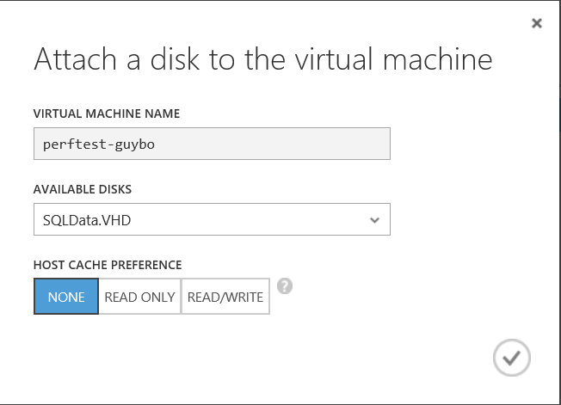
Disk Caching Best Practices for SQL Server
OS Disk
“Read Write” (default) reduces read latency for IO intensive workloads with smaller DBs (<=10GB)
Working set can fit in disk cache or memory, reducing blob storage IO
Data disks
Cache setting depends on the IO pattern and workload intensity
Use default of “None” (disable) for higher rate of random IOs (e.g. OLTP) & higher throughput
Bypasses physical host local disks, maximizing IO rate
Consider enabling read cache for latency sensitive read heavy workloads
Notes:
I/O sub-system
Storage optimization for SQL Server transactional and analytical workloads is a very important task that requires careful planning and analysis. There is already a tremendous amount of information that explains how to deal with I/O subsystems with different performance characteristics in a traditional on-premises environment, such as spindles, host bus adapters (HBAs), disk controllers, and so on. For more information, see Analyzing I/O Characteristics and Sizing Storage Systems for SQL Server Database Applications.
Azure disks are implemented as a service, so they do not offer the same range of complex configuration options available in traditional on-premises I/O subsystems. This has both benefits and costs. For instance, Azure disks offer built-in local redundancy and optional geo-redundancy for disaster recovery through the use of replicas. To achieve the same level of redundancy in on-premises deployments, you would need to set up multiple disk arrays in multiple locations and a synchronization mechanism, such as, a storage area network (SAN) replication. On the other hand, the Azure disk performance is not as predictable as on-premises disk I/O subsystem due to several factors:
Azure Infrastructure Services is a shared, multi-tenant service. Resources like host machines, storage services and network bandwidth are shared among multiple subscribers.
Performance may vary depending upon where and when you provision your virtual machines due to a variety of factors including differences in hardware. Your virtual machine may get moved to a different host due to a hardware replacement necessitated by a failure or lifecycle refresh.
The performance and availability of your virtual machines may be impacted (positively or negatively) by maintenance operations such as platform upgrades or performance and reliability fixes.
When you use cloud-based storage options in Azure, you sacrifice granular control and deep performance optimization options for lower costs, simplicity and out-of-the-box redundancy.
Azure disks are connected to virtual machines via a network infrastructure and that can introduce higher network latency compared to the local attached disks in on-premises environment.
For a detailed discussion on different storage configurations, see the Best practices and recommendations for optimizing SQL Server performance in Azure VMs section.

Slide 31
Configure Multiple Disks using Storage Spaces for IOPS
Notes:
Configure disks using storage spaces and add additional disks

Slide 32
SQL Server Recovery Options
Cold standby. A secondary data center that can provide availability within hours or days
SQL Backup to Azure
Warm standby. A secondary data center that can provide availability within minutes or hours
SQL Log Shipping
Hot standby. A nearby secondary instance that can provide availability within seconds or minutes and another remote replica for DR with longer recovery time
SQL AlwaysOn Availability Group

Slide 33
Cloud Backup Benefits
Decrease reliance on tape backup to save money and increase agility
Have confidence in the safety of your data with Azure’s cutting-edge security, privacy, and compliance practices
Decrease the management overhead of backup processes with automation
Reduce the dependence on offsite tape backup to accelerate recovery time
Long term retention 99+ years

Slide 34
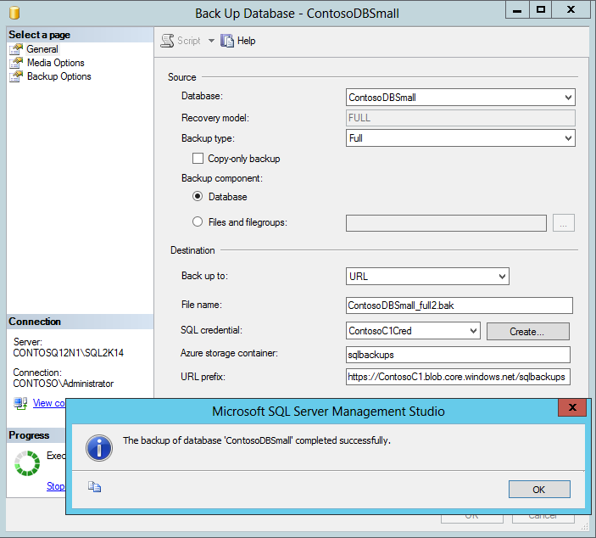

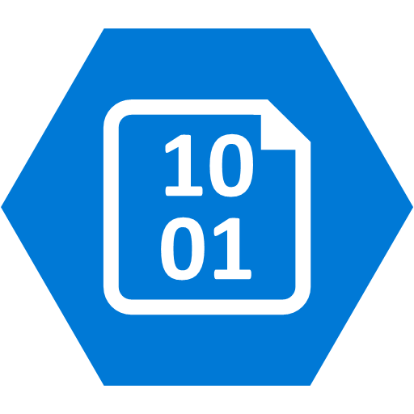

SQL Backup to URL (Azure Storage)
SQL DB
Azure Blob Storage
SQL DB
Notes:
Reference blog: https://technet.microsoft.com/en-us/library/jj919148%28v=sql.110%29.aspx?f=255&MSPPError=-2147217396
Key points about backing up DBs to Azure
URL: A URL specifies a Uniform Resource Identifier (URI) to a unique backup file. The URL is used to provide the location and name of the SQL Server backup file. In this implementation, the only valid URL is one that points to a page Blob in a Windows Azure storage account. The URL must point to an actual Blob, not just a container. If the Blob does not exist, it is created. If an existing Blob is specified, BACKUP fails, unless the “WITH FORMAT” option is specified.
If you choose to copy and upload a backup file to the Windows Azure Blob storage service, use page blob as your storage option. Restores from Block Blobs are not supported.
Credential: A SQL Server credential is an object that is used to store authentication information required to connect to a resource outside of SQL Server. Here, SQL Server backup and restore processes use credential to authenticate to the Windows Azure Blob storage service. The Credential stores the name of the storage account and the storage account access key values. Once the credential is created, it must be specified in the WITH CREDENTIAL option when issuing the BACKUP/RESTORE statements.

Slide 35


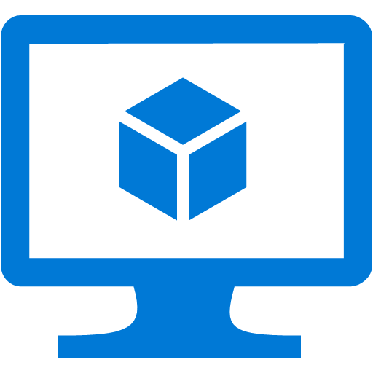

SQL Server AG log-ship and transfer to Azure
Azure VNET
DR on Azure
DR SQL log-ship target
WSFC SQL AG Listener
Sync
Commit
Restore logs from URL
Azure page blob
SQL DB Prim. Replica WSFC node 1
SQL DB Sec. Replica WSFC node 2
Cluster FSW
SQL log restore job
SQL log backup job
Site-to-site or Express Route
Notes:
https://technet.microsoft.com/library/ms187103.aspx explains log shipping
NO log ship to URL (Azure storage) directly yet
SQL Server Log shipping allows you to automatically send transaction log backups from a primary database on a primary server instance to one or more secondary databases on separate secondary server instances. The transaction log backups are applied to each of the secondary databases individually. An optional third server instance, known as the monitor server, records the history and status of backup and restore operations and, optionally, raises alerts if these operations fail to occur as scheduled.
AG can combine with Log shipping. its about controlling the data movement and restore delay on secondary database in log-shipping. Here is list of reasons why someone would use AlwaysOn Availability Group and Log Shipping together. Reasons for the combination are:
Delayed Recovery – In Log-shipping we can have definite delay on secondary database. This would safe guard DBA from “oops!” and “was that the production server?” situations. Log shipping can control the delay of transaction log restore while Asynchronous secondary replica can not.
Single DR Server – Single Server can be used as multiple log-shipping pair’s destination.
Infrastructure – Server at DR site can’t be a part of current cluster due to infrastructure limitations.
Technical – Secondary server is already a part of different windows failover cluster. In availability group, we can’t have overlap of nodes by two windows clusters.

Slide 36
SQL Log-Shipping - Things to Know
Schedule log backup and ship offsite to meet RPO requirement
No direct log ship to Azure storage yet
Apply logs base on desired delay time
Test recovery to ensure RTO is met

Slide 37
SQL Server Availability Replica on Azure
Azure VNET
DR SQL DB Sec. Replica
WSFC SQL AG Listener
Sync
Commit
Site-to-site or Express Route
SQL DB Prim. Replica WSFC node 1
SQL DB Sec. Replica WSFC node 2
Asynchronous commit
Cluster FSW
Notes:
In this SQL DR solution, we have three nodes in a Windows Server Failover Cluster stretched across two premises.
The two nodes on-premises offers automatic failover and zero data loss with synchronous replication
The remote node on Azure serves as a DR replica. For performance consideration of the application, this replica uses asynchronous replication which has the potential of data loss when failover. The failover is manual.
Benefits:
Not only can customers protect against system failure to keep up with SLA, they can also minimize planned down time. With rolling upgrade and maintenance, all planned maintenance and upgrades can be performed during business hours without taking the primary instance down.

Slide 38
Azure SQL AG Replica – Things to know
Network latency
Be careful about failing resources over via cluster manager
Manage SQL failover from AG Dashboard or TSQL
Infrastructure admin trained on AO AG

Slide 39
Recovery Services
Notes:
30 min left

Slide 40

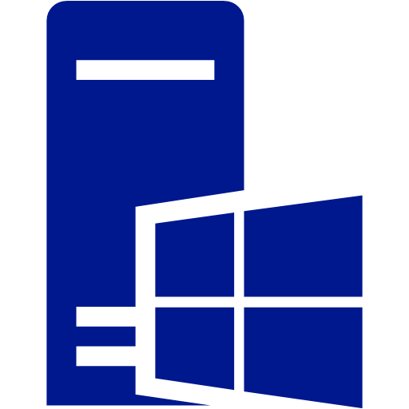
Azure Backup
Azure Backup
MS workload support
VmWare VM backup
Enterprise class data source support
Recover anywhere
Long term retention 99+ years
Azure
On-Premises
Backup/Restore
Notes:
Azure Integrated Backup Solution
Azure Backup protects your data in the cloud and optionally can be integrated with System Center Data Protection Manager for advanced workload protection.
Data protection schedules can be daily, monthly, weekly, and yearly with retention up to 99 years in Azure
Protects workloads running in Azure, in VMs, or on physical servers
Centralized monitoring and reporting across on premises and Azure
Advanced Workload Protection
Protects files and folders from Windows Servers and Windows Clients
Integrates with SCDPM protects enterprise workloads including SharePoint, Exchange, SQL Server, and Hyper-V VMs
Protects guest workloads running in VMware environments
DPM works seamlessly with the Hyper-V Volume Shadow Copy Services (VSS) writer to ensure that consistent versions of virtual machines are captured and protected without affecting virtual machine access
Granular restore capability such as mailbox recovery for Exchange, DB level recovery for SQL, and ILR for SharePoint
When setting up the Azure Backup Vault, selecting a region far away from your primary region is unnecessary. Azure Backup automatically copies the backup files to a remote region. So select a region close to your primary region for faster backups ??
Virtual machine backup is local. The backup vault from a specified Azure region will not allow you to backup virtual machines from another Azure region. Thus for every Azure region that has VMs that need backup, at least 1 backup vault must be created in that region.
Limitations for DPM backup to Azure
https://msdn.microsoft.com/en-us/library/azure/dn337337.aspx

Slide 41
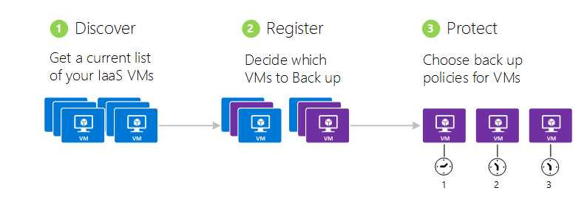
Azure Backup Steps
Notes:
Discover Azure virtual machines
The discovery process queries Azure for the list of virtual machines in the subscription, along with additional information like the Cloud Service name and the Region. The discovery process should always be run as the first step. This is to ensure that any new virtual machines added to the subscription are identified.
Register Azure virtual machines
Before a virtual machine can be protected it needs to be registered with the Azure Backup service. The primary goal of the registration process is to associate the virtual machine with the Azure Backup service. Registration is typically a one-time activity.
Protect: Backup Azure virtual machines
This step involves setting up a backup and retention policy for the virtual machine. Multiple virtual machines can be protected at scale using a single protect action.
See https://github.com/Azure/azure-content/blob/master/articles/backup/backup-azure-vms.md for more details

Slide 42
Azure Backup – Things to know
Supports 64-bits Windows Server and Windows clients
VM Backups are local to the region, need at least one vault per region
Supports VMs with up to 16 disks plus the OS disk
Supports encrypted disks
VM backups can be retained up to 99 years
Maximum 25 backup vaults per subscription
Up to 50 machines or 100 Azure VMs per vault
V2 VM support is in private preview
Backup for VM with premium storage in public preview

Slide 43
Azure Site Recovery

Slide 44


Azure Site Recovery One solution for multiple infrastructures
Replication
Replication
SAN
SAN
Replication
Microsoft Azure
Hyper-V
Hyper-V
Hyper-V
Hyper-V
Hyper-V
1
Hyper-V to Hyper-V (on-premises)
2
Hyper-V to Hyper-V (on-premises)
3
Hyper-V to Microsoft Azure
Replication
Replication
Microsoft Azure
VMware or Physical
VMware
VMware or Physical
4
VMware or Physical to VMware (on-premises)
5
VMware or Physical to Microsoft Azure
Notes:
Protection between two datacenters with VMM
Protection between two datacenters with VMware
Protection between a datacenter with VMM and Azure
Protection between a Hyper-V site and Azure
Protection between an on-premises physical server or VMware virtual machine and Azure
Protection between Amazon Web Services and Azure (Windows AMIs only)* (Note showed on diagram)
Migration between Azure regions and subscriptions*
Azure to Azure is only supported for migration, NO DR as of 1/12/2016

Slide 45
Designing Complex Solutions in the Cloud

Slide 46
Understand Service Limits, Quotas and Constraints
Storage and Subscription Limits
Cloud Service
Service Manager vs. ARM
Networking
Networking ARM
DNS
Notes:
You can roughly calculate the number of highly utilized disks supported by a single storage account based on the transaction limit. For example, for a Basic Tier VM, the maximum number of highly utilized disks is about 66 (20,000/300 IOPS per disk), and for a Standard Tier VM, it is about 40 (20,000/500 IOPS per disk). However, note that the storage account can support a larger number of disks if they are not all highly utilized at the same time.
35 premium, 40 standard for number of disks

Slide 47
Storage planning
Choose redundancy
Locally redundant storage (LRS)
Zone-redundant storage (ZRS)
Geo-redundant storage (GRS)
Read-access geo-redundant storage (RA-GRS)
IOPS/Disk are based on per/disk
Can combine multiple disks for increased IOPS
Choose IOPs
Understand tier (D-series)
Understand max per tier
Premium vs standard
Premium = SSD (regions)
Naming
Auto vs your own name
Instance vs. disk vs Image
Notes:
https://azure.microsoft.com/en-us/documentation/articles/azure-subscription-service-limits/#virtual-machines-limits
https://azure.microsoft.com/en-us/documentation/articles/storage-scalability-targets/
https://azure.microsoft.com/en-us/documentation/articles/storage-redundancy/
IOPS 8k reads and writes – SQL
Software RAID vs. Storage Spaces

Slide 48
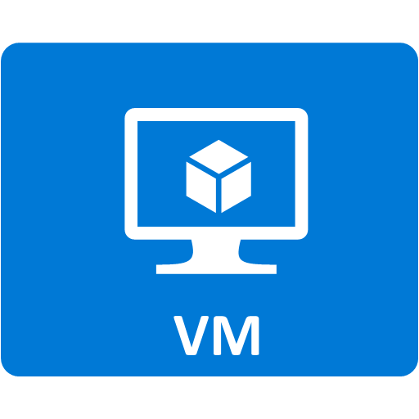
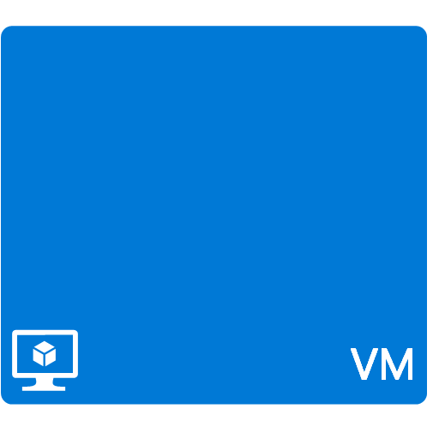



Understanding the Cost Components
Bandwidth in/out
Connectivity
Notes:
See http://www.windowsazure.com/en-us/pricing/calculator/ for up to date information
Service
Description
Cost
1. In/Out Bandwidth
This is the web traffic between the user's browser and the site.
Inbound: Free
Outbound (North America and Europe): $0.12 per GB
2. Compute
Virtual machines, for the time each one is running.
Small size virtual machine: $0.115 per hour
Medium size virtual machine: $0.23 per hour
Cloud Services roles, for the time each role is running.
Small size role: $0.12 per hour
Medium size role: $0.24 per hour
3. Azure Storage
Up to 1 TB with geo-replication: $0.125 per GB
Up to 1 TB without geo-replication: $0.09 per GB
4. Transactions
Each interaction with the storage system is billed.
$0.01 per 100,000 transactions
5. Database
SQL Server hosted in a VM
Small or medium size VM: $0.55 per hour
Azure SQL Database, cost per month.
Up to 100 MB: $4.995
Up to 1 GB: $9.99
Up to 10 GB: First GB $9.99, each additional GB $3.996
Up to 50 GB: First 10 GB $45.954, each additional GB $1.998
Up to 150 GB: First 50 GB $125.874, each additional GB $0.999
6. Connectivity
Virtual Networks and Connect
$0.05 per hour per connection

Slide 49
ASR – Things to know
Linux is supported at OS level, applications need to be tested at failover
ASR is available in ALL regions (including Gov.)
Network bandwidth is key, ExpressRoute is a good idea
VM OS drive support limited to 1 disk up to 1TB in size
VM data disks supports up to 32 drives
Hyper-V VMs replicated to V2 VMs supported
VMWare VMs to V2 VMs dues soon
Azure to Azure DR in private preview
Notes:
Considerations >> https://azure.microsoft.com/en-us/documentation/articles/site-recovery-vmware-to-azure-classic-legacy/
For old WS 2003 systems:
Windows Server 2003 32-bit and 2008 32-bit support on Azure for CSA customers
Customers must have migrations plans from Windows Server 2003 to more modern versions before deploying to Azure. Migration Only, not DR for now?
Ensure CS can communicate with MT, PS, and source
Configure endpoints and vNets after migration

Slide 50
ASR Planning Tool
Plan capacity for virtual machine and physical server protection in Azure Site Recovery
https://azure.microsoft.com/en-us/documentation/articles/site-recovery-capacity-planner/
Azure Site Recovery Capacity Planner
https://gallery.technet.microsoft.com/Azure-Recovery-Capacity-d01dc40e

Slide 51
Linux on Azure

Slide 52





Azure-Endorsed Linux Distributions
Created by partners, curated & tested by Microsoft
Standard Images
Contact Linux vendor/partner for Linux support
Azure-related issues supported by Microsoft
Oracle
Linux
openSUSE
OpenLogic
CentOS-based
Canonical
Ubuntu
Premium Images
Microsoft engages the Linux vendor/partner on behalf of the customer for support
Includes updates, patches, and support through 24x7 web, email, chat and phone
SUSE SLES 11SP3 only
SUSE Linux Enterprise Server
Notes:
These are all Azure endorsed Linux distributions but only SUSE SLES is certified for SAP as of end of calendar year 2015

Slide 53
Installing the Azure Linux Agent
Available either included in Azure-endorsed Linux distributions or directly from Github
Installation using a RPM or DEB package is preferred
Manual installation by copying waagent to /usr/sbin/waagent and running:
# sudo chmod 755 /usr/sbin/waagent
# /usr/sbin/waagent -install -verbose

Slide 54
Azure Linux Agent
What It Does
Provisioning of the image (host name, user account, SSH keys, disk mgmt)
Manages networking (routes for DHCP servers, network interface name)
Kernel functions (virtual NUMA, Hyper-V entropy & SCSI timeouts)
Redirects console to the serial port for debugging
How it Communicates
A boot-time attached DVD for IaaS deployments
A TCP endpoint exposing a REST API used to obtain deployment and topology configuration
Notes:
https://azure.microsoft.com/en-us/documentation/articles/virtual-machines-linux-agent-user-guide/

Slide 55
About VM Extensions
VM Extensions
Software components that extend the functionality of the VM
Multiple extensions can be added, updated or removed
Installed and managed by the Azure Linux Agent
Support for Linux
Recent SUSE (applicable for SAP), Ubuntu, and OpenLogic images have been updated to include the new agent
Notes:
VM Extensions implement most of the critical functionality that you want to use with your VMs, including basic functionality like resetting passwords, configuring RDP, and many, many others. Because new extensions are added all the time, the number of possible features your VMs support in Azure continues to increase. For example: VMAccess Extension, OS patching extension, Docket extension. See https://azure.microsoft.com/en-us/documentation/articles/virtual-machines-extensions-configuration-samples-linux/ for more.
VMAccess Extension can:
Reset the password of the original sudo user
Create a new sudo user with the password specified
Set the public host key with the key given
Reset the public host key provided during VM provisioning if host key not provided
Open the SSH port(22) and restore the sshd_config if reset_ssh is set to true
Remove the existing user
Check disks
Repair added disk

Slide 56
SAP/Linux on Azure Certification
Newly Announced
Certified
SAP HANA developer, enterprise editions on SLES (announced at SAPphire in May)
SAP Hybris
We are working on
SAP Netweaver on SLES (planned for Summer 2016)
SAP Netweaver on RHEL (planned for mid 2016)
HANA enterprise edition on SLES (planned for summer 2016)

Slide 57
Extending Storage to Azure

Slide 58





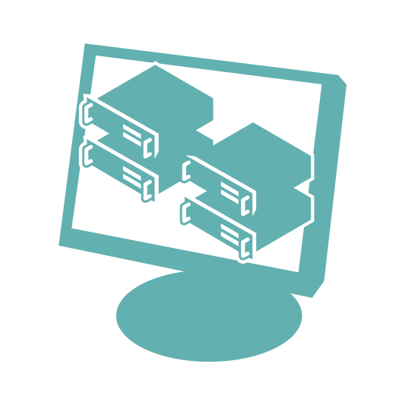


StorSimple on-premises & in the cloud
StorSimple connects Hyper-V, VMware and Linux servers to Azure Storage, seamlessly, with no application modification
Customer Data Center
Smaller Enterprise Environment
SAN
SAN
NAS
Enterprise
Hybrid
NAS or SAN
storage
Local or tiered volumes
Hyper-V
Hyper-V
Linux
Linux
VMware
VMware
SAN
StorSimple Physical
StorSimple Virtual Array
Automated offsite data protection using cloud snapshots
Highly efficient, location independent disaster recovery
Internet
Azure-based
Applications
iSCSI
Data mobility for enterprise data
Consolidated storage &
data management
StorSimple Cloud Appliance
StorSimple
Manager
Notes:
StorSimple is a hybrid storage device. It’s a storage device that you put in your data center and it instantly connect to Azure. It’s a small 2U device that speaks iSCSI that extends itself to Azure storage. It’s used for backup, archive as well as normal application storage.
StorSimple solutions integrate advanced SAN technologies such as SSDs, SAS, automated storage tiering, encryption, deduplication and compression with the cloud to reduce the storage footprint as well as CapEx and OpEx costs.
Benefits:
Manage data growth and lower storage costs up to 60%
Cloud storage is used to offload inactive data from on-premises and for storing backup and archive data
Inline deduplication and compression reduce storage growth rates and increase storage utilization
Solid state drives (SSD) deliver low-cost input/output per second
Streamline storage and management
Primary, backup, snapshot, archive and offsite storage are converged into a hybrid cloud storage solution
All storage functions are controlled centrally from an Azure management portal *
Automated cloud snapshots replace costly remote replication and time-consuming tape management
Improve disaster recovery and compliance
Instant recovery downloads only the data needed by applications for fast RTOs (recovery time objectives)
Data retention is determined by software policies instead of backup system capacity or tape rotations
Disaster recovery testing can be done without disrupting normal daily operations
Migrate and copy data through the cloud
StorSimple Virtual Appliance makes enterprise data available to VMs running in Azure for dev/test, disaster recovery and DR testing, and other cloud applications *
Data uploaded to the cloud can be accessed from other sites for recovery and data migrations

Slide 59


Consolidated Management
Azure StorSimple Manager
Registration Key
Service Data Encryption Key
On-Premises StorSimple_PhysicalAppliance
On-Premises StorSimple_VirtualArray *Preview
Azure StorSimple_VirtualAppliance
Notes:
With a StorSimple device installed at your data centre, you provision a StorSimple Manager on Azure. Work through the following steps to manage the on-premises device as well as the storage extension behind the storage appliance.
Get service registration key - You need a service registration key to register your devices.
Register the device - Go to the Windows PowerShell interface and use the service registration key to register your physical device and connect to StorSimple Manager service. Virtual devices are registered as part of device configuration.
Complete device configuration - After registering your device from the Windows PowerShell interface, complete the required device configuration from the device list. It may take a few minutes for the registered device to appear in the list.
The on-premises StorSimple Virtual Array available to all customers with an Enterprise Agreement for Microsoft Azure. The StorSimple Virtual Array is a version of the StorSimple solution in a virtual machine form installed on your existing hypervisors. The virtual array can be run as a virtual machine on your Hyper-V or VMware ESXi hypervisors and can be configured as a File Server (NAS) or as an iSCSI server.
StorSimple Manager service in Azure portal and manages one or more StorSimple appliances. All management of the hybrid storage include the on-premises devices, the Azure virtual device, backup catalog, jobs etc is done in one place (on Azure)

